Slide 1
Secure data hiding in images using steganography
CAPSTONE PROJECT
Presented By:
Student Name : LAVANYA SHARMA
College Name & Department : Manipal Institute of Technology (Bengaluru), Computer Science Engineering (Cyber Security)

Slide 2
OUTLINE
Problem Statement
Technology used
Wow factor
End users
Result
Conclusion
Git-hub Link
Future scope

Slide 3
Problem Statement
Traditional encryption methods often make data protection easily detectable, which increases the risk of interception. This project utilizes image steganography to conceal secret messages within images through Least Significant Bit (LSB) encoding. The hidden message remains undetectable, providing secure and covert communication. This technique improves data security without drawing attention.

Slide 4
Technology used
Windows 11 operating system
Python programming language
IDLE (Python 3.11)
Libraries: open cv2, os, String,
Encrypted images in output

Slide 5
Wow factors
Effortless & Accessible: Works with any standard image, making secure communication simple.
Invisible Encryption: Conceals messages within images without changing their visible appearance
Dual Security: Combines steganography with password protection for added security.
No Suspicion: Unlike traditional encryption, it remains discreet and doesn't raise any suspicion.
Lightweight & Fast: Requires minimal processing time, with no need for large encryption keys.

Slide 6
End users
Military
IT industry
MNCs
Cyber security analysts and professionals.

Slide 7
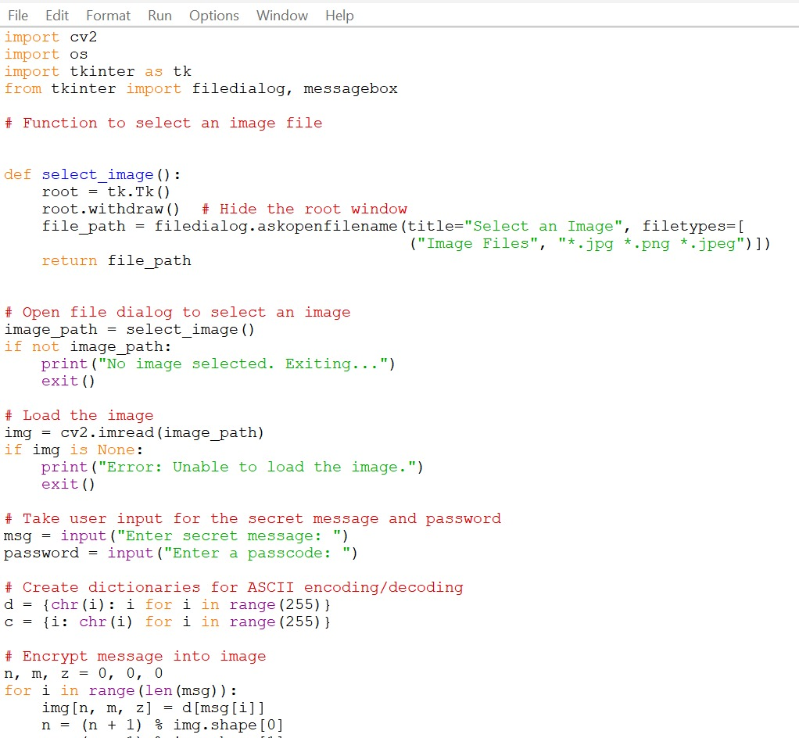
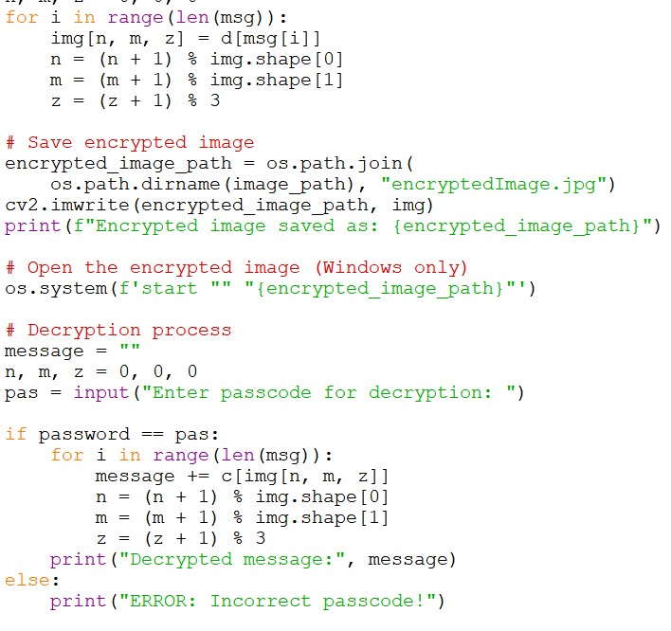
Results (code)

Slide 8
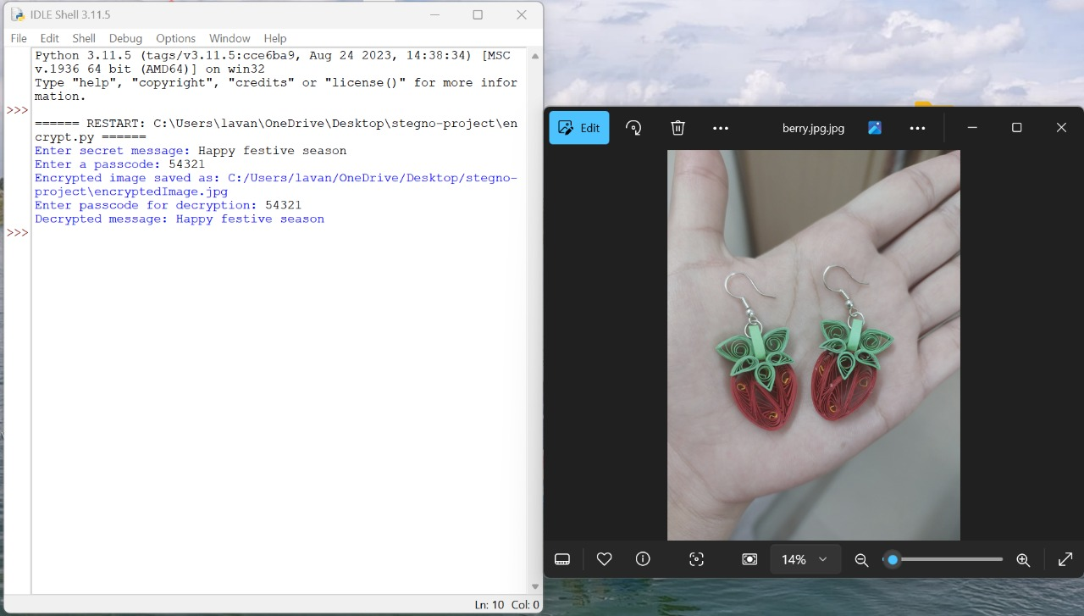
(Output)

Slide 9
Conclusion
In a time when data security is a growing concern, this project offers a creative and subtle solution for secure communication. By using image steganography with Least Significant Bit (LSB) encoding, it enables users to embed messages within images without changing their visible appearance. Unlike traditional encryption techniques, this method keeps sensitive data hidden, minimizing the chance of interception.
Moreover, incorporating password protection adds an extra layer of security, ensuring that only authorized individuals can access the concealed message. This approach is invaluable for cybersecurity experts, journalists, businesses, and anyone who needs a secure, efficient, and discreet way to exchange confidential information.

Slide 10
GitHub Link
https://github.com/ghlavanya/skillsbuild_project.git

Slide 11
THANK YOU

